Slide 1
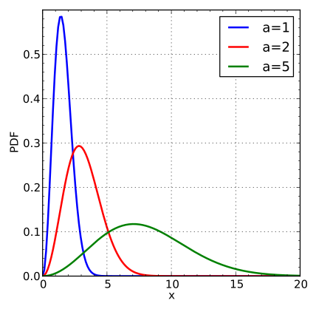
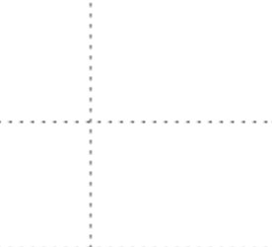
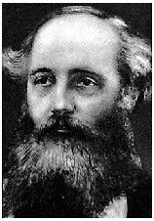
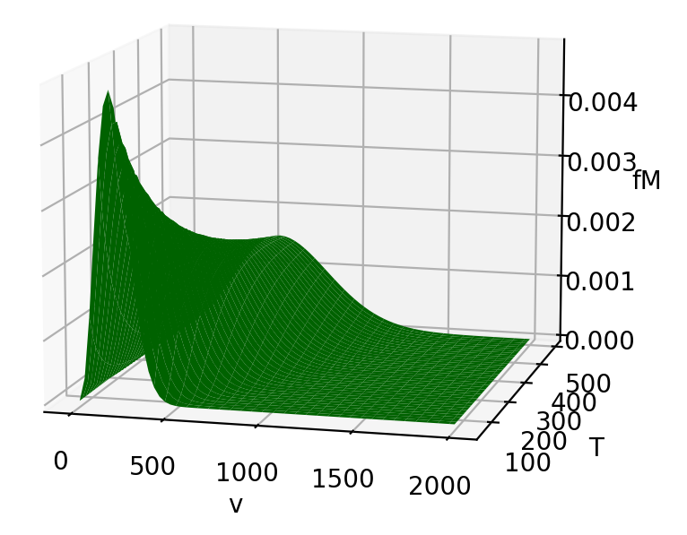

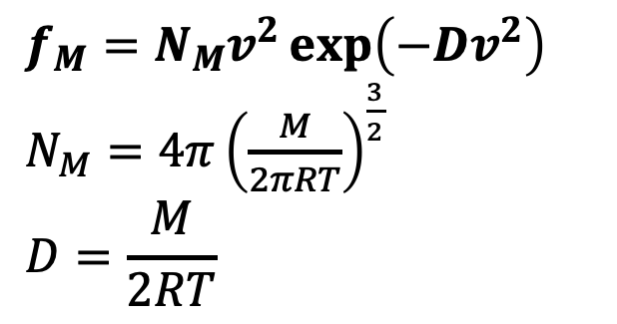
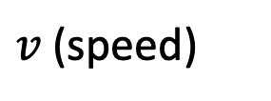
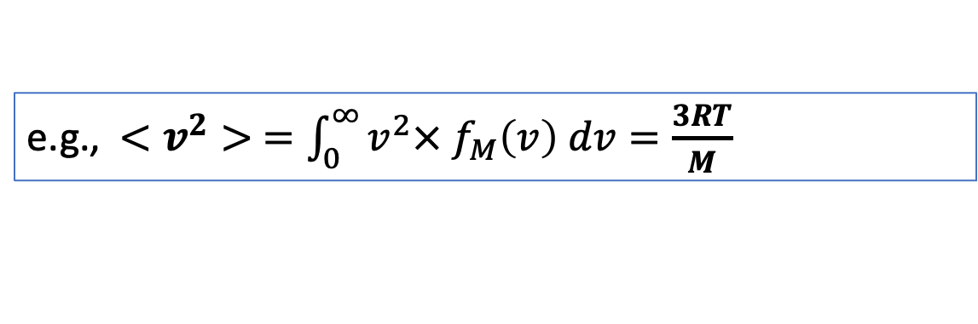
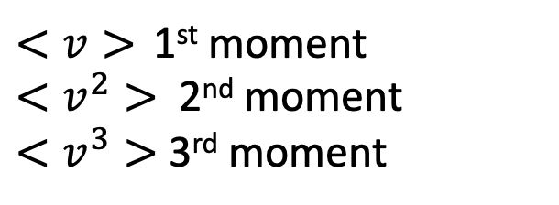
Moments from the Maxwell probability density
$$f_{M}=N_{M}v^{2}\exp\left(−Dv^{2}\right)$$
$N_{M}=4π{\left(\frac{M}{2πRT}\right)}^{\frac{3}{2}}$
$$D=\frac{M}{2RT}$$
$<v>$ 1st moment
$<v^{2}>$ 2nd moment
$<v^{3}>$ 3rd moment
$$f_{M}$$
$v$ (speed)
e.g., $<v^{2}> =\int_{0}^{∞}{v^{2}× f_{M}\left(v\right) dv}=\frac{3RT}{M}$

Slide 2
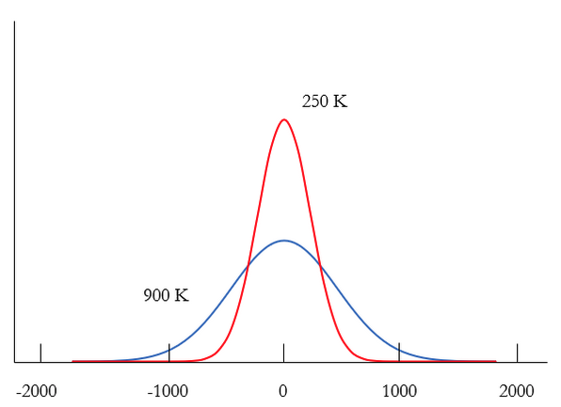
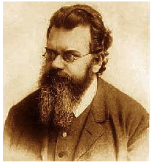
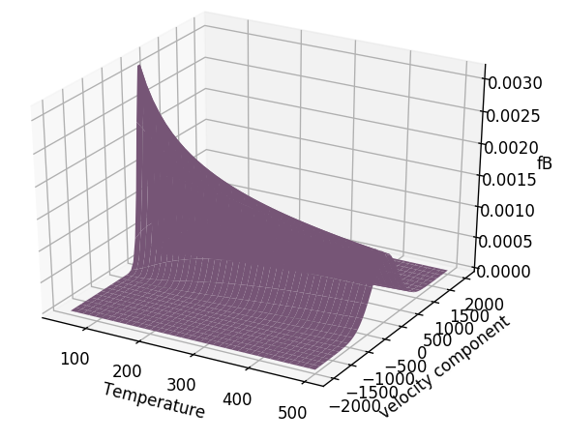

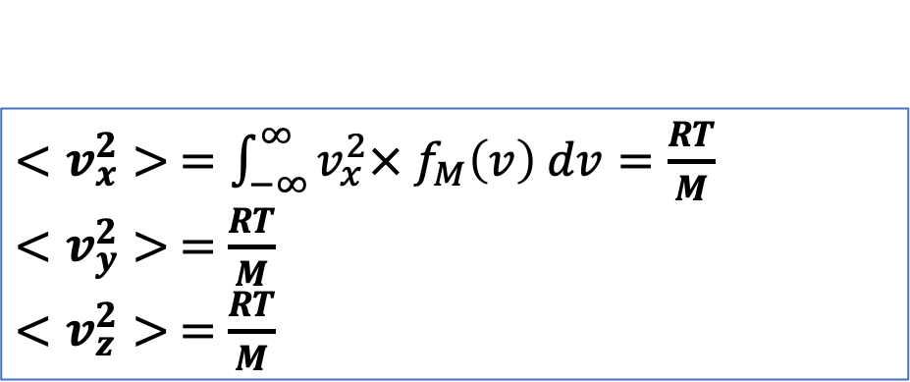
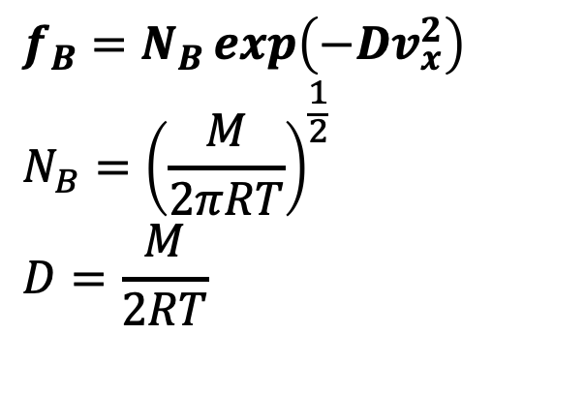


Moments from the Boltzmann probability density
$$f_{B}=N_{B}\exp\left(−Dv_{x}^{2}\right)$$
$${N_{B}=\left(\frac{M}{2πRT}\right)}^{\frac{1}{2}}$$
$$D=\frac{M}{2RT}$$
$$f_{B}(v_{x})$$
$<v_{x}>$ 1st moment
$<v_{x}^{2}>$ 2nd moment
$<v_{x}^{3}>$ 3rd moment
$$v_{x}$$
$<v_{x}^{2}> =\int_{−∞}^{∞}{v_{x}^{2}× f_{M}\left(v\right) dv}=\frac{RT}{M}$
$<v_{y}^{2}> =$ $\frac{RT}{M}$
$<v_{z}^{2}> =$ $\frac{RT}{M}$

Slide 3
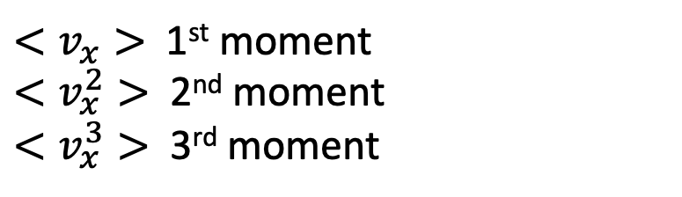



Moments from the Boltzmann probability density
$$f_{B}=N_{B}\exp\left(−Dv_{x}^{2}\right)$$
$${N_{B}=\left(\frac{M}{2πRT}\right)}^{\frac{1}{2}}$$
$$D=\frac{M}{2RT}$$
$<v_{x}>$ 1st moment
$<v_{x}^{2}>$ 2nd moment
$<v_{x}^{3}>$ 3rd moment
$$f_{B}(v_{x})$$
$$v_{x}$$
BTW, $<v_{x}> =0$ and $<v_{x}^{3}> =0$

Slide 4
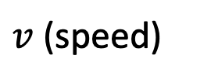
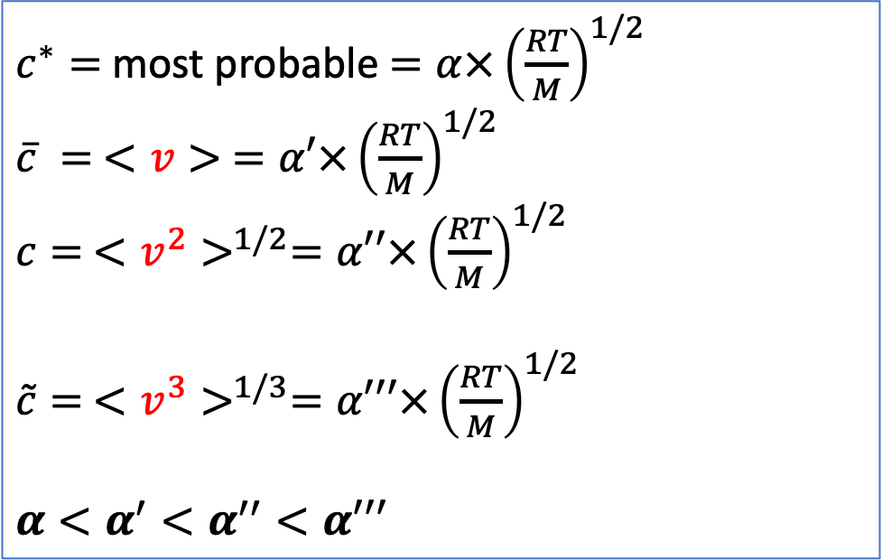
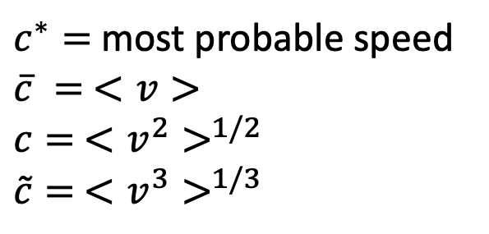

Back to Maxwell: the c’s and how they’re ordered
$$f_{M}=N_{M}v^{2}\exp\left(−Dv^{2}\right)$$
$N_{M}=4π{\left(\frac{M}{2πRT}\right)}^{\frac{3}{2}}$
$$D=\frac{M}{2RT}$$
$<v>$ 1st moment
$<v^{2}>$ 2nd moment
$<v^{3}>$ 3rd moment
$$f_{M}$$
$c^{∗}=$ most probable speed
$\overline{c} = <v>$
$c= <v^{2}>^{1/2}$
$\tilde{c}= <v^{3}>^{1/3}$
$c^{∗}=$ most probable $=α×{\left(\frac{RT}{M}\right)}^{1/2}$
$\overline{c} = <v> =α′×{\left(\frac{RT}{M}\right)}^{1/2}$
$c= <v^{2}>^{1/2}=α′′×{\left(\frac{RT}{M}\right)}^{1/2}$
$\tilde{c}= <v^{3}>^{1/3}=α′′′×{\left(\frac{RT}{M}\right)}^{1/2}$
$$α<α^{′}<α^{′′}<α′′′$$
$v$ (speed)
$v$ (speed)
$$c^{∗}<\overline{c}<c<\tilde{c}$$

Slide 5
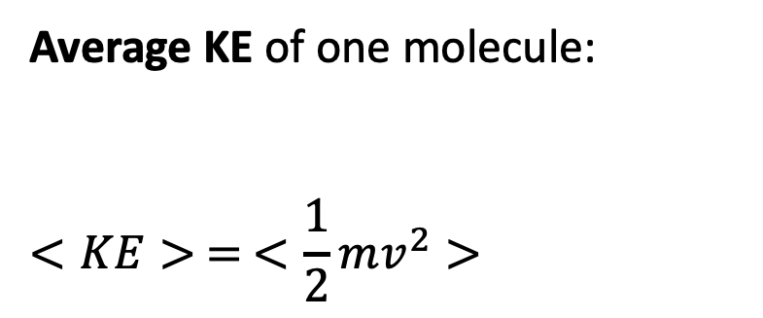
Average kinetic energy
Average KE of one molecule:
$$<KE> = <\frac{1}{2}mv^{2}>$$

Slide 6
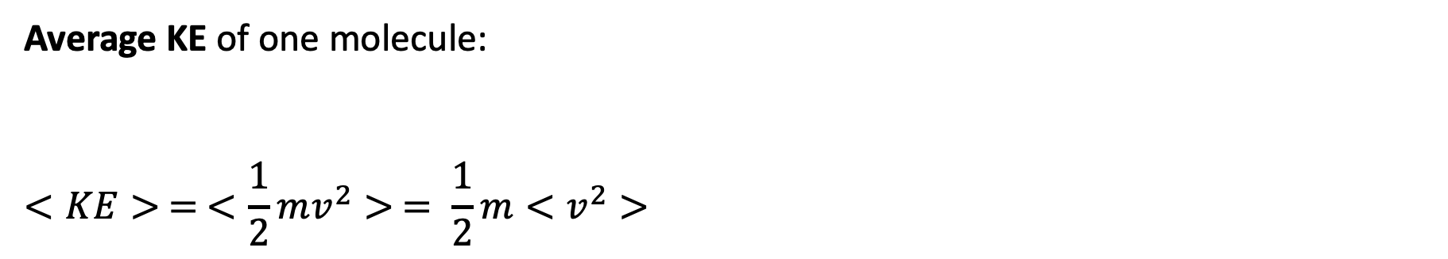
Average kinetic energy
Average KE of one molecule:
$$<KE> = <\frac{1}{2}mv^{2}> = \frac{1}{2}m<v^{2}>$$

Slide 7
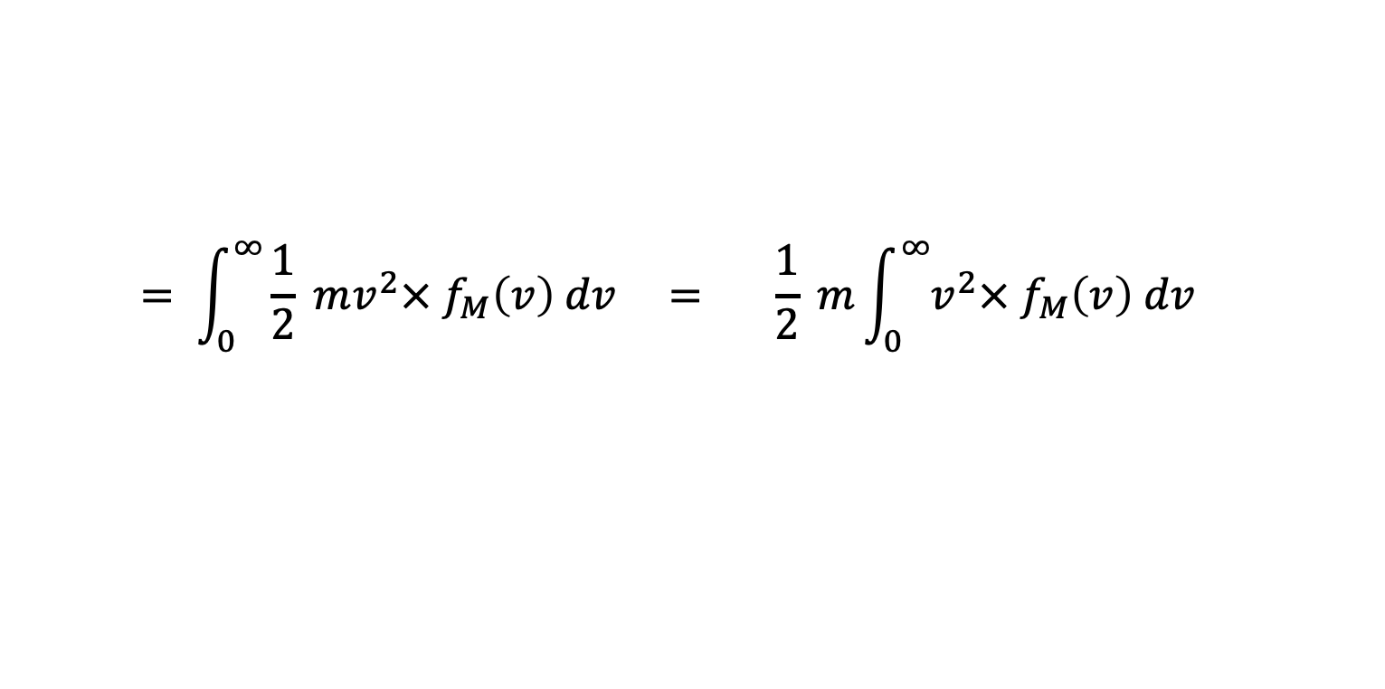
Average kinetic energy
Average KE of one molecule:
$$<KE> = <\frac{1}{2}mv^{2}> = \frac{1}{2}m<v^{2}>$$
$$= \int_{0}^{∞}{\frac{1}{2} mv^{2}× f_{M}\left(v\right) dv} = \frac{1}{2} m\int_{0}^{∞}{v^{2}× f_{M}\left(v\right) dv}$$

Slide 8
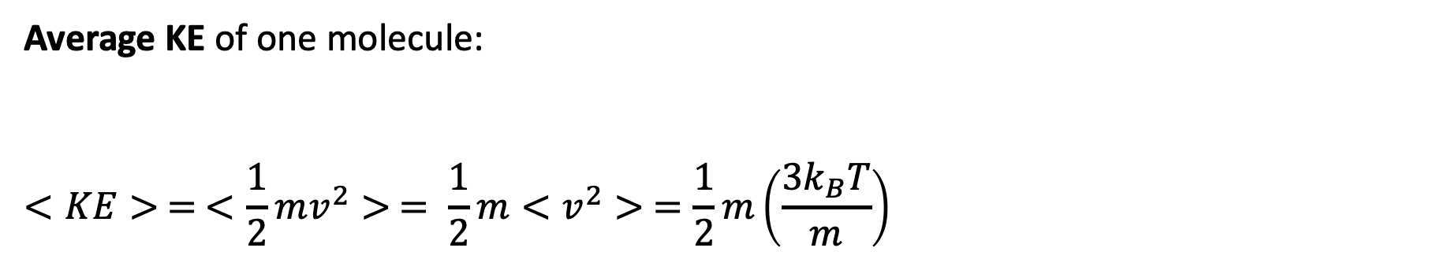
Average kinetic energy
Average KE of one molecule:
$$<KE> = <\frac{1}{2}mv^{2}> = \frac{1}{2}m<v^{2}> =\frac{1}{2}m\left(\frac{3k_{B}T}{m}\right)$$

Slide 9
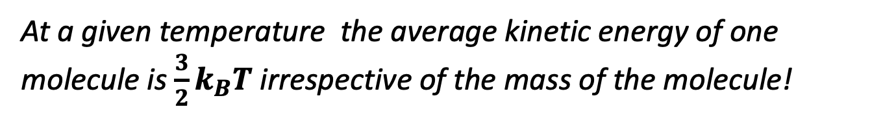
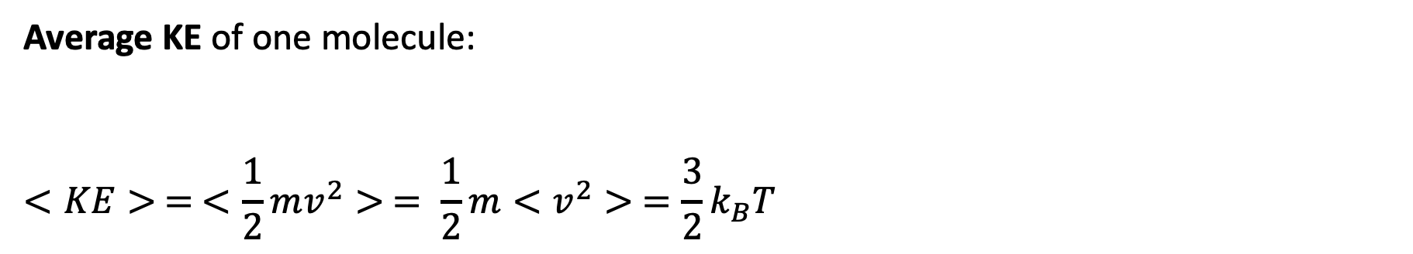
Average kinetic energy
Average KE of one molecule:
$$<KE> = <\frac{1}{2}mv^{2}> = \frac{1}{2}m<v^{2}> =\frac{3}{2}k_{B}T$$
At a given temperature the average kinetic energy of one molecule is $\frac{3}{2}k_{B}T$ irrespective of the mass of the molecule!

Slide 10
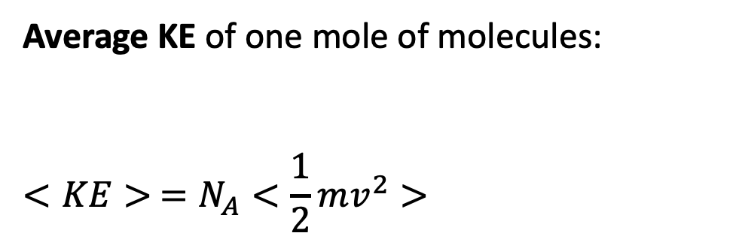
Average kinetic energy
Average KE of one mole of molecules:
$$<KE> =N_{A}<\frac{1}{2}mv^{2}>$$
Pretend there are 6.02 x 10²³ of these

Slide 11
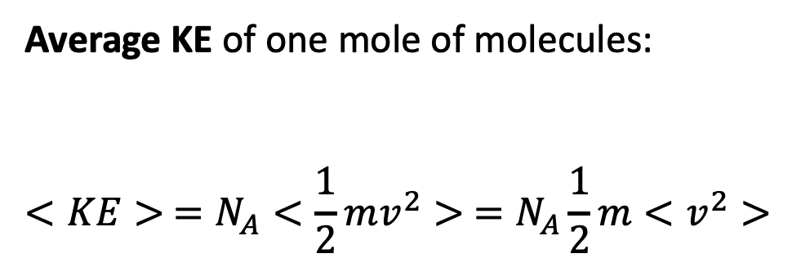
Average kinetic energy
Average KE of one mole of molecules:
$$<KE> =N_{A}<\frac{1}{2}mv^{2}> =N_{A}\frac{1}{2}m<v^{2}>$$
Pretend there are 6.02 x 10²³ of these

Slide 12
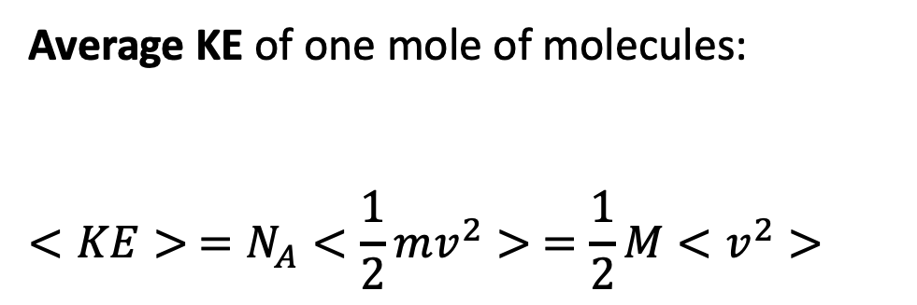
Average kinetic energy
Average KE of one mole of molecules:
$$<KE> =N_{A}<\frac{1}{2}mv^{2}> =\frac{1}{2}M<v^{2}>$$
Pretend there are 6.02 x 10²³ of these

Slide 13
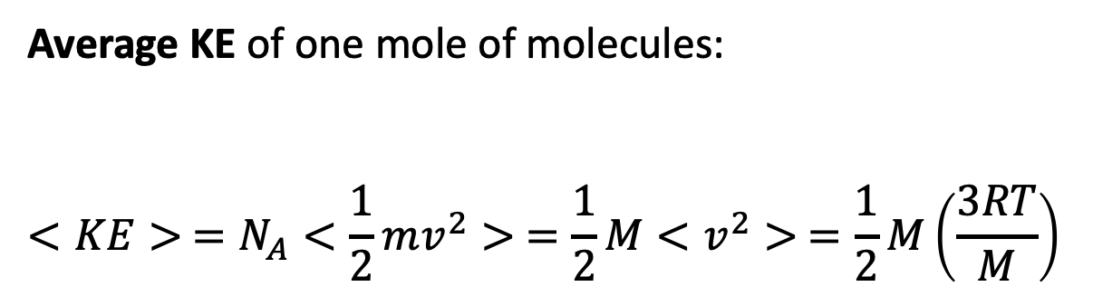
Average kinetic energy
Average KE of one mole of molecules:
$$<KE> =N_{A}<\frac{1}{2}mv^{2}> =\frac{1}{2}M<v^{2}> =\frac{1}{2}M\left(\frac{3RT}{M}\right)$$
Pretend there are 6.02 x 10²³ of these

Slide 14
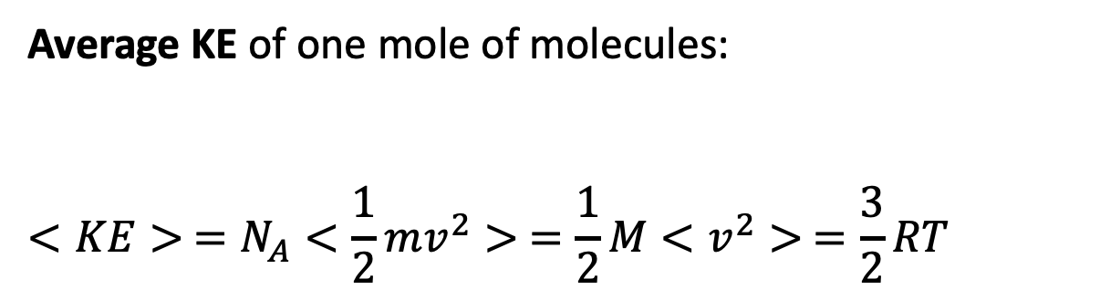
Average kinetic energy
Average KE of one mole of molecules:
$$<KE> =N_{A}<\frac{1}{2}mv^{2}> =\frac{1}{2}M<v^{2}> =\frac{3}{2}RT$$
Pretend there are 6.02 x 10²³ of these

Slide 15
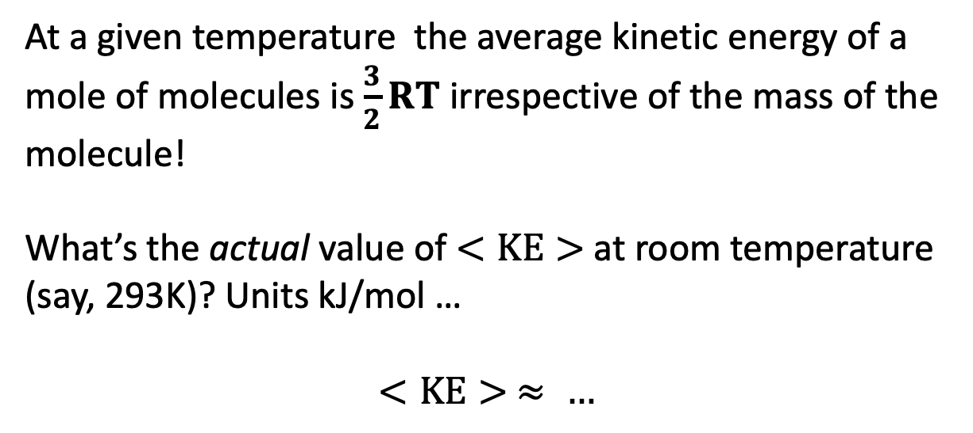
Average kinetic energy
Average KE of one mole of molecules:
$$<KE> =N_{A}<\frac{1}{2}mv^{2}> =\frac{1}{2}M<v^{2}> =\frac{3}{2}RT$$
Pretend there are 6.02 x 10²³ of these
At a given temperature the average kinetic energy of a mole of molecules is $\frac{3}{2}RT$ irrespective of the mass of the molecule!
What’s the actual value of $<KE>$at room temperature (say, 293K)? Units kJ/mol …
$$<KE> ≈ …$$

Slide 16
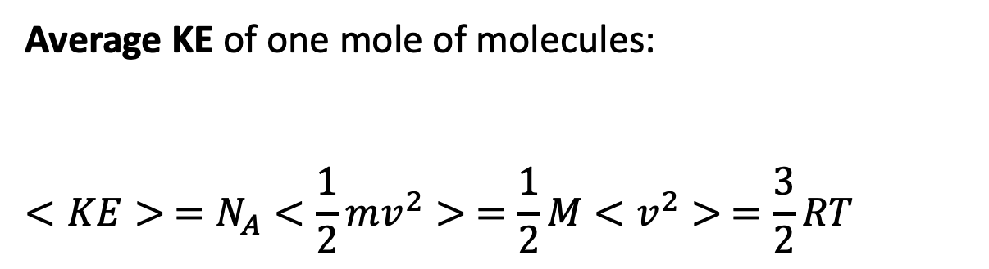
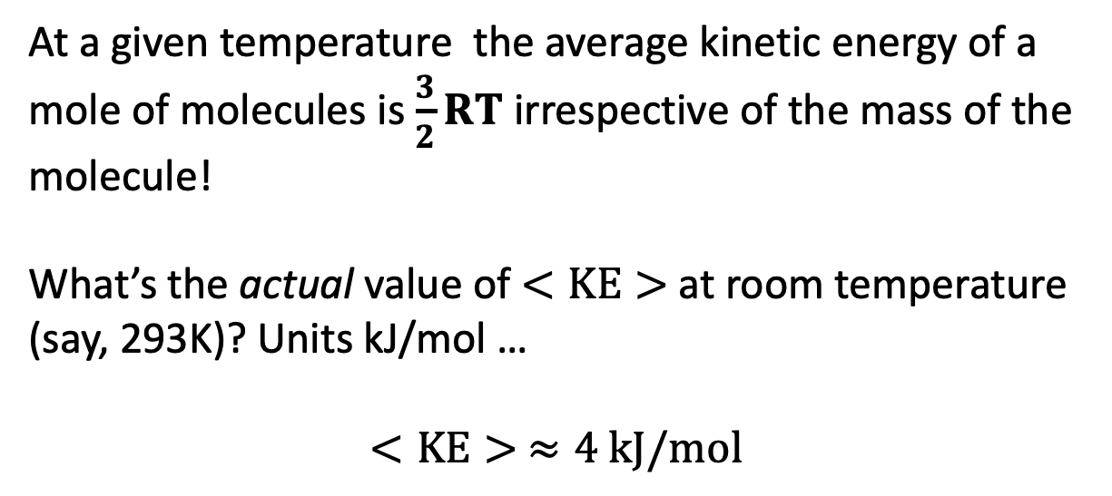
Average kinetic energy
Average KE of one mole of molecules:
$$<KE> =N_{A}<\frac{1}{2}mv^{2}> =\frac{1}{2}M<v^{2}> =\frac{3}{2}RT$$
Pretend there are 6.02 x 10²³ of these
At a given temperature the average kinetic energy of a mole of molecules is $\frac{3}{2}RT$ irrespective of the mass of the molecule!
What’s the actual value of $<KE>$at room temperature (say, 293K)? Units kJ/mol …
$$<KE> ≈4 kJ/mol$$

Slide 17
Average kinetic energy
Average KE of one mole of molecules:
$$<KE> =N_{A}<\frac{1}{2}mv^{2}> =\frac{1}{2}M<v^{2}> =\frac{3}{2}RT$$
Pretend there are 6.02 x 10²³ of these
At a given temperature the average kinetic energy of a mole of molecules is $\frac{3}{2}RT$ irrespective of the mass of the molecule!
What’s the actual value of $<KE>$at room temperature (say, 293K)? Units kJ/mol …
$$<KE> ≈4 kJ/mol$$
So the question arises, are collisions at room temperature able to break:
Covalent bonds?
van der Waals bonds (what we’ve called “stickiness”)?

